Slide 1
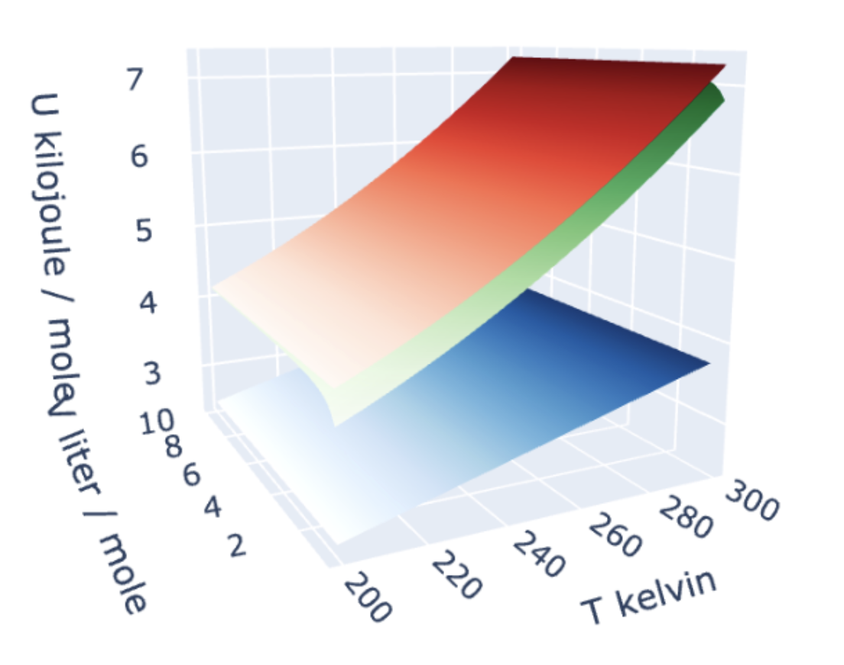

Recap: $U(T,V)$ is a measure of a system’s energy
The energy in a sample (say, a mole of gas) can take various forms:
There’s translational and rotational motion, which is all kinetic energy:
$$U(T,V)$$
There’s also vibrational motion, in which kinetic energy and potential energy are constantly trading off.

Slide 2
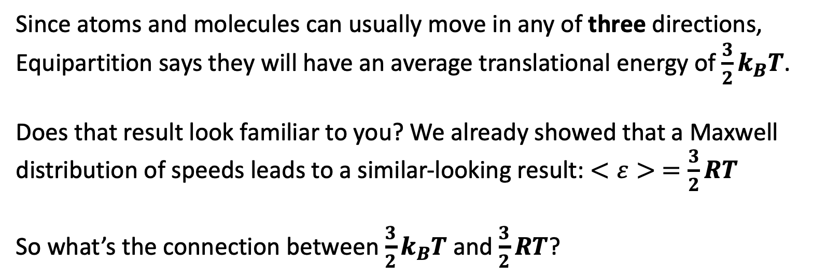
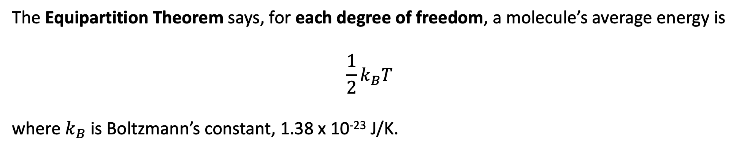
Predicting $U(T,V)$ from the Equipartition Theorem
The Equipartition Theorem says, for each degree of freedom, a molecule’s average energy is
$$\frac{1}{2}k_{B}T$$
where $k_{B}$ is Boltzmann’s constant, 1.38 x 10⁻²³ J/K.
Since atoms and molecules can usually move in any of three directions, Equipartition says they will have an average translational energy of $\frac{3}{2}k_{B}T$.
Does that result look familiar to you? We already showed that a Maxwell distribution of speeds leads to a similar-looking result: $<ε> =\frac{3}{2}RT$
So what’s the connection between $\frac{3}{2}k_{B}T$ and $\frac{3}{2}RT$?

Slide 3
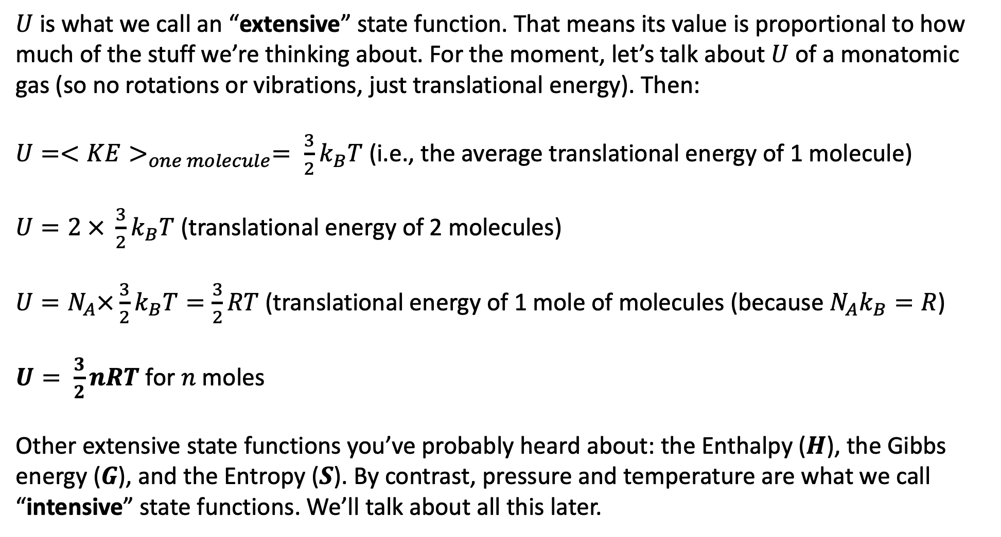
Extensive and intensive state functions
$U$is what we call an “extensive” state function. That means its value is proportional to how much of the stuff we’re thinking about. For the moment, let’s talk about $U$ of a monatomic gas (so no rotations or vibrations, just translational energy). Then:
$U=<KE>_{one molecule}= \frac{3}{2}k_{B}T$ (i.e., the average translational energy of 1 molecule)
$U=2 × \frac{3}{2}k_{B}T$ (translational energy of 2 molecules)
$U=N_{A}×\frac{3}{2}k_{B}T=\frac{3}{2}RT$ (translational energy of 1 mole of molecules (because ${N_{A}k}_{B}=R$)
$U= \frac{3}{2}nRT$ for $n$ moles
Other extensive state functions you’ve probably heard about: the Enthalpy ($H$), the Gibbs energy ($G$), and the Entropy ($S$). By contrast, pressure and temperature are what we call “intensive” state functions. We’ll talk about all this later.

Slide 4
Our graphs clearly show $U$going up with increasing temperature (here assuming $n=1$ mole)
$$U(T,V)$$
Faster at high T
Slower at low T

Slide 5
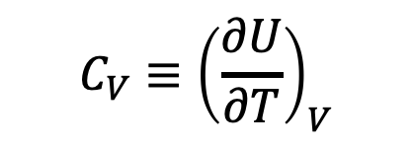
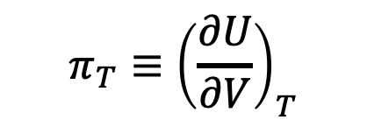

And don’t forget how we define the slopes of $U(T,V)$
$$U(T,V)$$
$$C_{V}{≡\left(\frac{∂U}{∂T}\right)}_{V}$$
$$π_{T}{≡\left(\frac{∂U}{∂V}\right)}_{T}$$
Faster at high T
Slower at low T

Slide 6
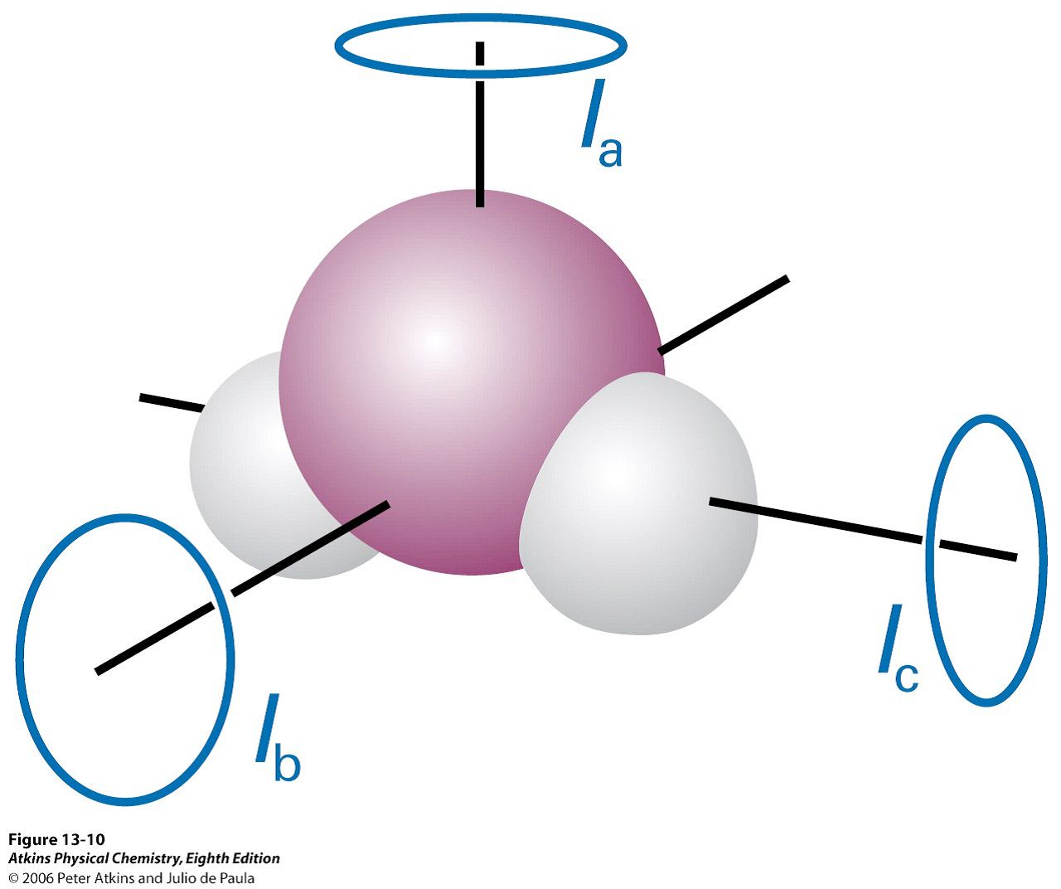
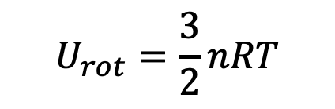
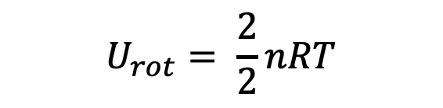
But what about rotations and vibrations? They also soak up/store energy.
Diatomic/Linear molecules can rotate in-plane and out-of-plane, so two rotational degrees of freedom
$$U_{rot}= \frac{2}{2}nRT$$
Nonlinear molecules can rotate in three distinct directions ( called principal axes), so three rotational degrees of freedom
$$U_{rot}=\frac{3}{2}nRT$$

Slide 7

Why do we think those other modes will get their $\frac{1}{2}RT$ (for each degree of freedom)?
We’ve already mentioned the process of transfer of energy from one degree of freedom to another: thermalization. Here’s how we imagine translational -> rotational thermalization happening:
$$U(T,V)$$

Slide 8
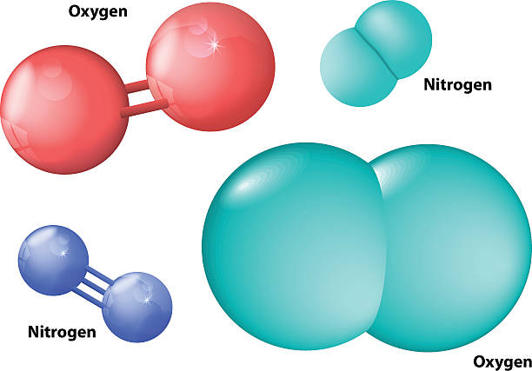
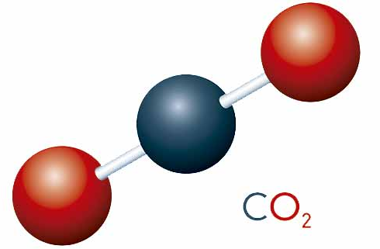
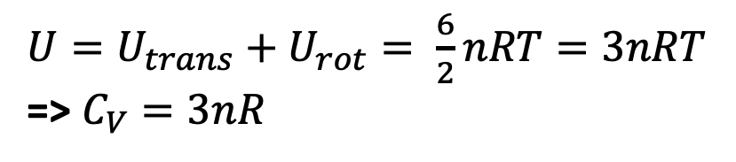
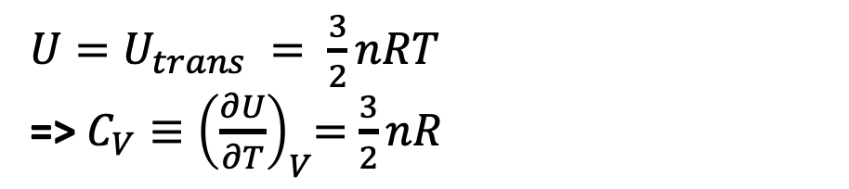
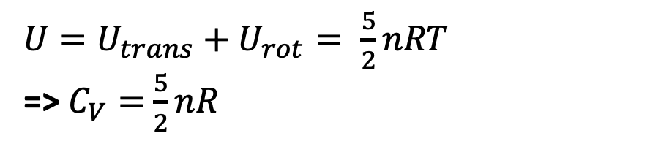
Why am I telling you all this? Because it shows how to build up $U$ and $C_{V}$
$U=U_{trans} = \frac{3}{2}nRT$
=> $C_{V}{≡\left(\frac{∂U}{∂T}\right)}_{V}=$ $\frac{3}{2}nR$
Atomic gas
Diatomic and linear molecules
${U=U_{trans}+U}_{rot}= \frac{5}{2}nRT$
=> $C_{V}=$ $\frac{5}{2}nR$
Nonlinear molecules
${U=U_{trans}+U}_{rot}= \frac{6}{2}nRT=3nRT$
=> $C_{V}=3nR$

Slide 9
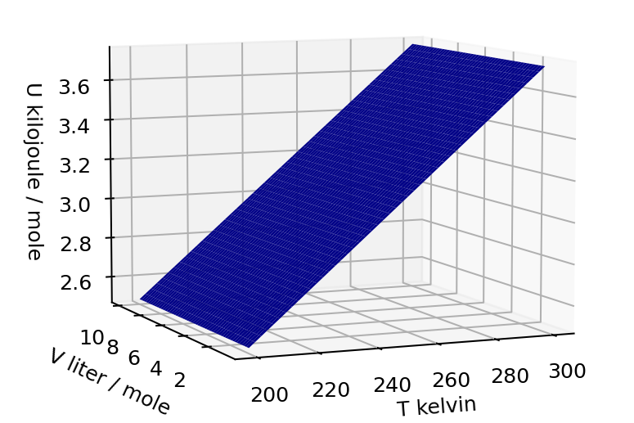
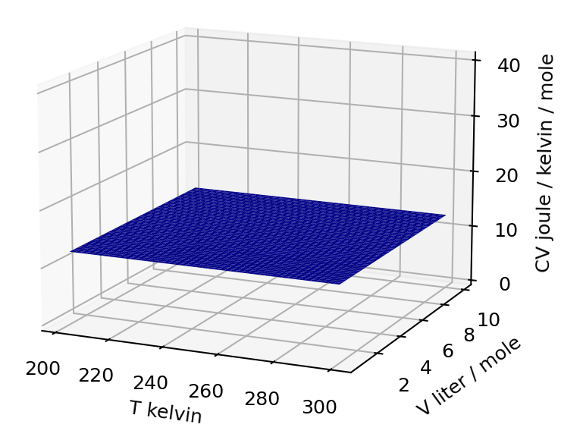
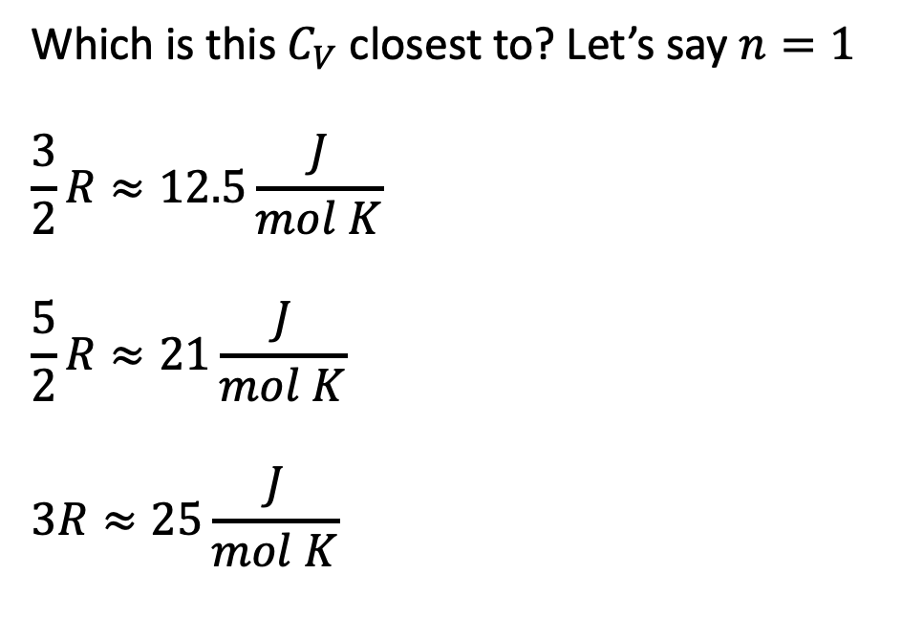


We can tell whether this molecule can rotate by looking at the value of $C_{V}$
$$U(T,V)$$
Which is this $C_{V}$ closest to? Let’s say $n=1$
$$\frac{3}{2}R≈12.5\frac{J}{mol K}$$
$$\frac{5}{2}R≈21\frac{J}{mol K}$$
$$3R≈25\frac{J}{mol K}$$
$$C_{V}(T,V)$$

Slide 10
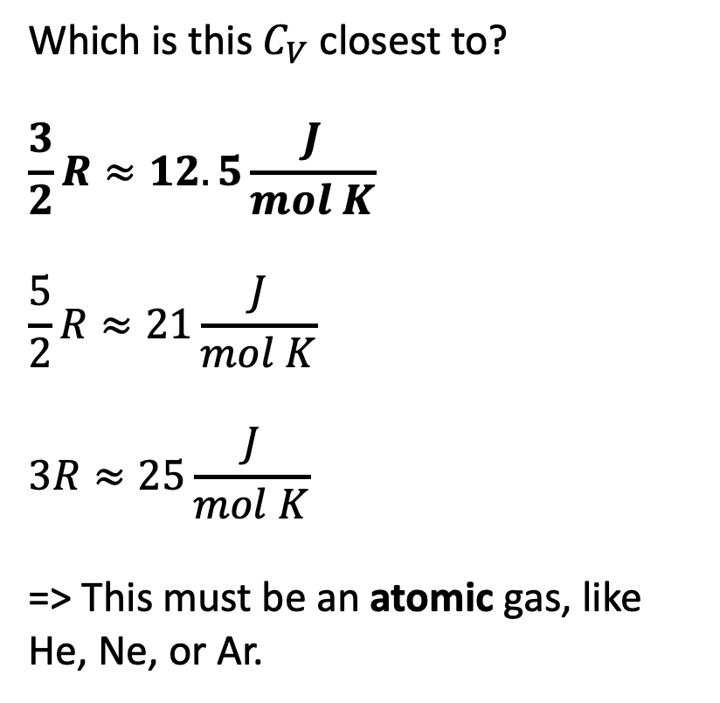
We can tell whether this molecule can rotate by looking at the value of $C_{V}$
$$U(T,V)$$
Which is this $C_{V}$ closest to?
$$\frac{3}{2}R≈12.5\frac{J}{mol K}$$
$$\frac{5}{2}R≈21\frac{J}{mol K}$$
$$3R≈25\frac{J}{mol K}$$
=> This must be an atomic gas, like He, Ne, or Ar.
$$C_{V}(T,V)$$

Slide 11
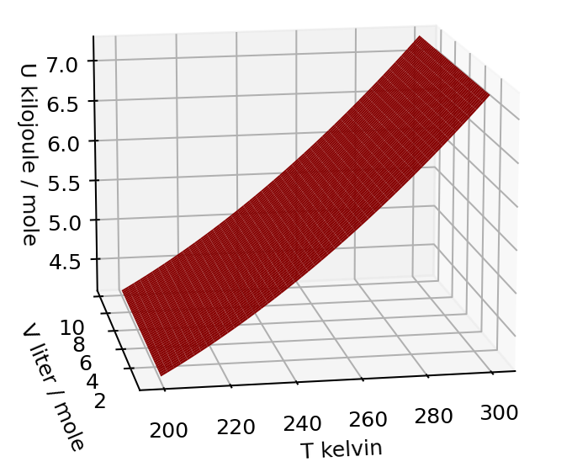
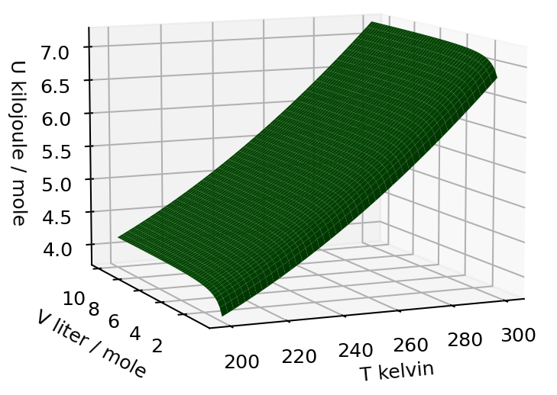
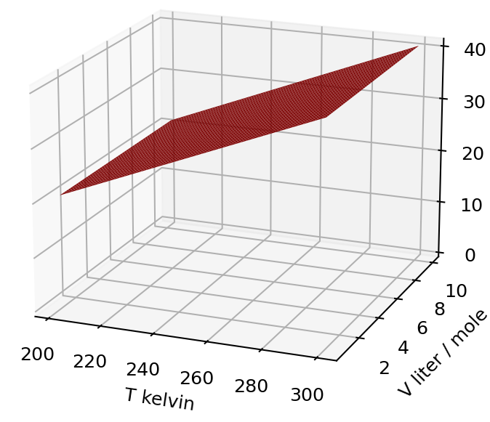
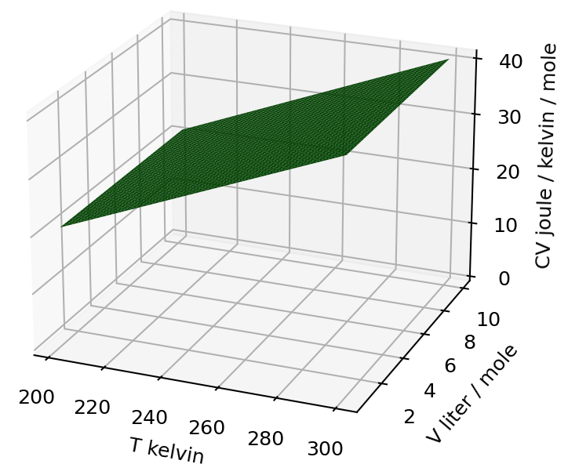


Now … what can we learn from the fact that the other two don’t have constant $C_{V}$?
$$U(T,V)$$
$$C_{V}(T,V)$$
Constant slope in the temperature direction
Increasing slope in the temperature direction

Slide 12
To understand these, we have to understand how molecules vibrate
$$U(T,V)$$
$$C_{V}(T,V)$$
Constant slope in the temperature direction
Increasing slope in the temperature direction

